Slide 1
Weather App Daudi Ibrahim ST10459491

Slide 2
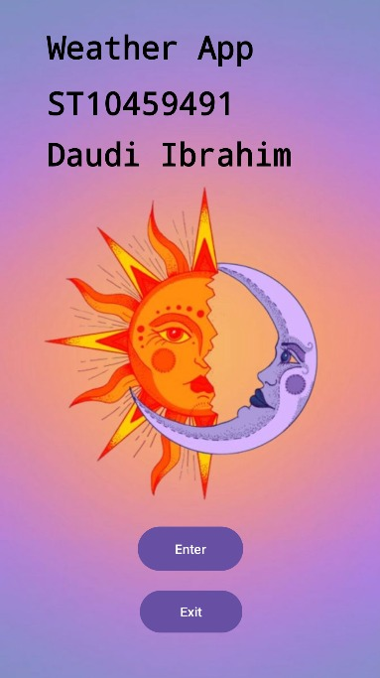
Introduction Creating a weather application that provides users with up-to-date and detailed weather information is an essential service for many, especially those who need to plan their daily activities around weather conditions. I recently developed a native Android weather app using Kotlin in Android Studio for a local weather organization. The app is designed to display the weekly weather forecast, including average temperatures and detailed daily weather conditions. This essay outlines the development process, the key features of the app, and the steps I took to handle potential errors effectively.

Slide 3

The purpose of the weather app is to provide users with a comprehensive and intuitive tool for accessing weather forecasts. It delivers weekly weather information, including average temperatures and detailed daily conditions, to help users make informed decisions and plan their activities effectively. By offering easy navigation and clear data presentation, the app aims to enhance user convenience and ensure that weather information is readily accessible and understandable.
Purpose Of The App

Slide 4

Conclusion
Developing this native Android weather app using Kotlin in Android Studio was a rewarding experience that allowed me to apply my programming skills and knowledge of mobile app development. The app provides users with easy access to weekly weather forecasts and detailed daily information, making it a valuable tool for planning and decision-making. By implementing robust error-handling mechanisms, I ensured that the app remains user-friendly and reliable, providing a seamless experience for all users. This project not only enhanced my technical skills but also deepened my understanding of the importance of usability and error management in mobile app development.

Slide 5

thank you

